Slide 1
The Web Today

Slide 2
The web platform is Write Once, Cry Everywhere
— Yehuda Katz

Slide 3
Browsers

Slide 4
The March From the Microsoft Monoculture to Today’s Relative Chaos
In the early 2000s, there was basically one browser, one platform and one screen resolution that mattered. In the end of its dominance Internet Explorer held market share of near or above 90% for most of the first half of the decade of the 2000s.

Slide 5




!!!

Slide 6
Realistically…
There are basically four broad streams in the world of browser development. At the heart of each of these streams is a rendering engine.

Slide 7
Rendering Engines
Microsoft’s EdgeHTML powers Edge. EdgeHTML is a fork of Trident, which powers Internet Explorer. Trident is serviceable. EdgeHTML is pretty great.
Browsers based on the WebKit open source project. This used to be a larger category (more on that in a second) but still includes Apple’s Safari on the desktop, iOS Safari and a number of other smaller browsers.
Browsers based on the Blink open source project. Forked from Webkit in 2013, Blink is the layout engine behind Chrome and Opera.
Mozilla’s Gecko is running under the hood of Firefox.

Slide 8
JavaScript Engines
In addition to the rendering engine, each of these streams has an associated JavaScript engine, which completes the core platform functionality for each when packaged as a web browser.
Chakra Is used in Microsoft Edge. Interestingly, it compiles scripts on a separate CPU core, parallel to the web browser.
Nitro The JavaScript engine for WebKit.
V8 is the JavaScript engine used in Google Chrome and Blink-derived versions of Opera. It’s also at the core of Node.js. V8 was the first JavaScript engine to compile JavaScript to native code before executing it, increasing performance significantly from previous engines.
SpiderMonkey The JavaScript engine in Firefox. The heir to the original JavaScript engine written by JavaScript’s creator Brendan Eich.

Slide 9
The Evergreen Browsers Are Pretty Good
Safari (tied to OS releases) and, especially IE (dead, but still hanging on), not so much

Slide 10
The Open Web Platform

Slide 11
The Open Web Platform
If, in the late 1990s/early 2000s, you were the kind of person who paid attention to their activities you could wait for years for anything interesting to happen.
In December 1997 the W3C published the HTML4.0 specification
In early 1998 they published the XML 1.0 Standard
In May 1998 the Cascading Style Sheets (CSS) level 2 specification
The ECMASCript Specification version 3.0 was released in December 1999
XHTML 1.0, the specification that redefined HTML as a subset of XML was published as a recommendation in January 2000
SVG 1.0 became a W3C Recommendation on 4 September 2001
After that, not much happened for many years

Slide 12

Well, this happened…

Slide 13
Keeping The Web Alive
Big 🙏 to the following for their work during the dark ages
Web Standards Project (WaSP)
A List Apart
Peter Paul Koch
Eric Meyer
And many others!

Slide 14
It’s a lot better now
Things have been on the upswing for over a decade

Slide 15
The WHATWG
The WHATWG was born at the W3C Workshop on Web Applications and Compound Documents in June, 2004. This W3C meeting was organized around the new (at the time) W3C activity in the web application space and included representatives from all the major browser vendors as well as other interested parties. There, in the first, ten-minute presentation of session 3 on the first day of the two day event, representatives from Mozilla and Opera presented a joint paper describing their vision for the future of web application standards. This position paper was authored in response to the slow general pace of innovation at the W3C and the W3C’s focus on XML based technologies like xHTML over HTML.
It birthed the WHATWG and, eventually, HTML5

Slide 16
New Standards Were Born
Web Forms 2.0: An incremental improvement of HTML4.01′s forms.
Web Apps 1.0: Features for Application Development in HTML.
Web Controls 1.0: A specification describing mechanisms for creating new interactive widgets.
Web Controls has since gone dormant, but the other two, Web Forms and Web Apps eventually formed the foundation of the HTML5 specification.

Slide 17
AJAX
On 18 February 2005, Jesse James Garrett, co-founder and president of design consultancy Adaptive Path, wrote an article entitled “Ajax: A New Approach to Web Applications.” In it, he described a new, at the time, trend in apps like Gmail and Google Maps that focused on smooth application like experiences. He coined the term Ajax to describe it and called the pattern “a fundamental shift in what’s possible on the Web.”
JavaScript is important again.

Slide 18
Current standards development landscape
ECMAScript ECMAScript mailing list https://esdiscuss.org/1 is where all the action happens.
HTML and related APIs Main development of what's referred to as the "living standard" happens with the WHATWG (https://whatwg.org/) This work is an ongoing extension of the work done for HTML5. See: https://github.com/whatwg
CSS CSS development has been broken down into smaller modules. CSS 2.0 was a monolithic specification that covered everything to do with CSS. For CSS3 the decision was made to break down the specification into specific features. This means there are some modules further along in the development process than others. The W3C's big list of modules is available here http://www.w3.org/TR/2001/WD-css3-roadmap-20010523/#module.

Slide 19
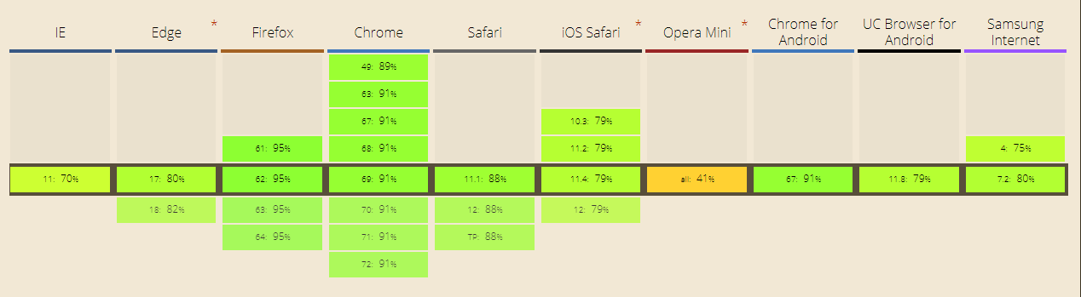
caniuse CSS3?
https://caniuse.com/#search=css3

Slide 20
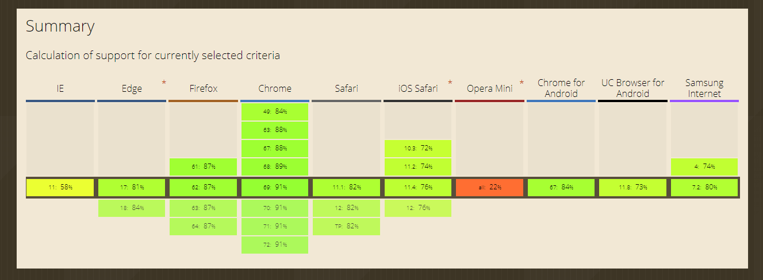
caniuse HTML5?
https://caniuse.com/#cats=HTML5

Slide 21
EcmaScript

Slide 22
ES4 ES3.1 ES5… ES6…
The specification for JavaScript was in limbo for many years. There were controversies. There was infighting. Eventually, after 7 years (!) a major release of the specification came out in 2009, EcmaScript 5.0. We are now, starting with ES6/ES2015, going with annual updates to the spec (ES2016, etc.)
There’s lots of fun stuff:

Slide 23
ES6 Features
Constants
Constants
Scoping
Block-Scoped Variables
Block-Scoped Functions
Arrow Functions
Expression Bodies
Statement Bodies
Lexical this
Extended Parameter Handling
Default Parameter Values
Rest Parameter
Spread Operator
Template Literals
String Interpolation
Custom Interpolation
Raw String Access

Slide 24
ES6 Features
Extended Literals
Binary & Octal Literal
Unicode String & RegExp Literal
Enhanced Regular Expression
Regular Expression Sticky Matching
Enhanced Object Properties
Property Shorthand
Computed Property Names
Method Properties

Slide 25
ES6 Features
Destructuring Assignment
Array Matching
Object Matching, Shorthand Notation
Object Matching, Deep Matching
Object And Array Matching, Default Values
Parameter Context Matching
Fail-Soft Destructuring
Modules
Value Export/Import
Default & Wildcard

Slide 26
ES6 Features
Classes
Class Definition
Class Inheritance
Class Inheritance, From Expressions
Base Class Access
Static Members
Getter/Setter
Symbol Type
Symbol Type
Global Symbols
Iterators
Iterator & For-Of Operator

Slide 27
ES6 Features
Generators
Generator Function, Iterator Protocol
Generator Function, Direct Use
Generator Matching
Generator Control-Flow
Generator Methods
Map/Set & WeakMap/WeakSet
Set Data-Structure
Map Data-Structure
Weak-Link Data-Structures
Typed Arrays
Typed Arrays

Slide 28
ES6 Features
New Built-In Methods
Object Property Assignment
Array Element Finding
String Repeating
String Searching
Number Type Checking
Number Safety Checking
Number Comparison
Number Truncation
Number Sign Determination

Slide 29
ES6 Features
Promises
Promise Usage
Promise Combination
Meta-Programming
Proxying
Reflection

Slide 30
ES6 Features
Internationalization & Localization
Collation
Number Formatting
Currency Formatting
Date/Time Formatting
Internationalization & Localization
Date/Time Formatting
Format date/time with localized ordering and separators.
Thanks: http://es6-features.org/

Slide 31
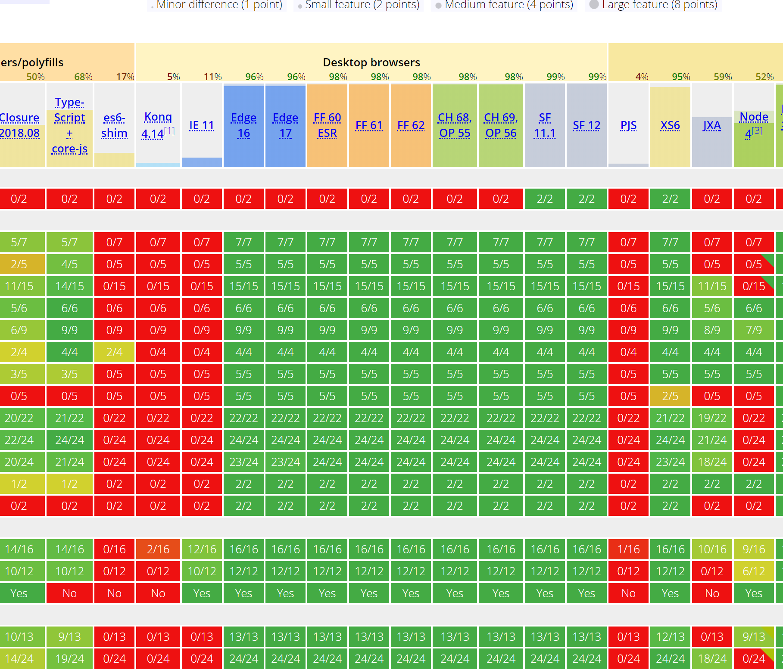
ES6 https://kangax.github.io/compat-table/es6/
https://kangax.github.io/compat-table/es6/

Slide 32
ES6 https://kangax.github.io/compat-table/es6/

Slide 33

ES6 https://kangax.github.io/compat-table/es6/

Slide 34
Enter Transpilers
Babel (https://babeljs.io/)
TypeScript (https://www.typescriptlang.org/)
Sass (https://sass-lang.com/)

Slide 35
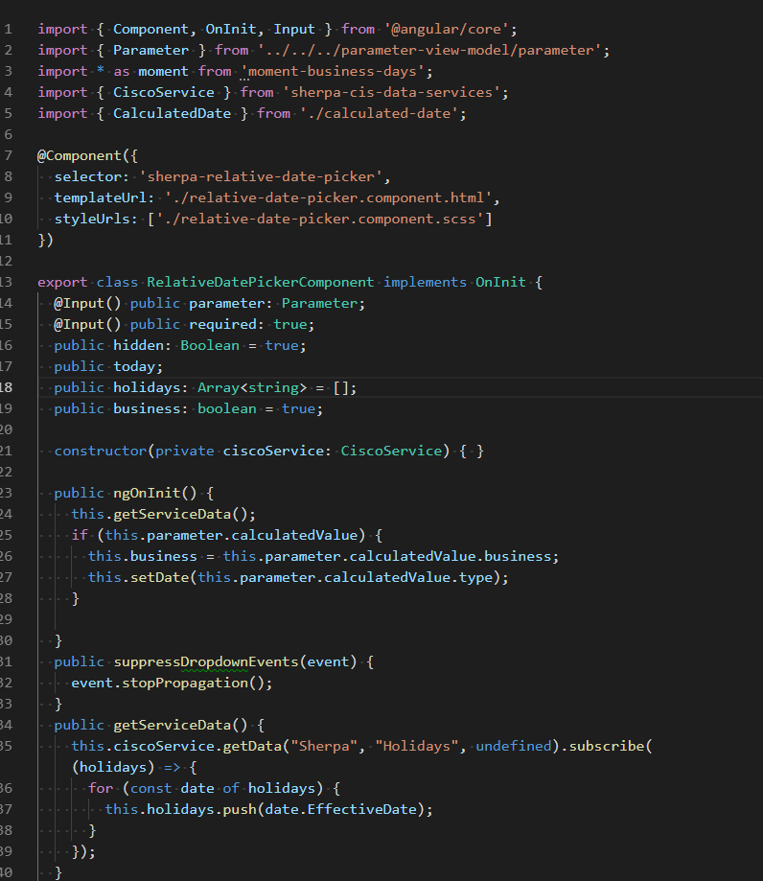

Slide 36
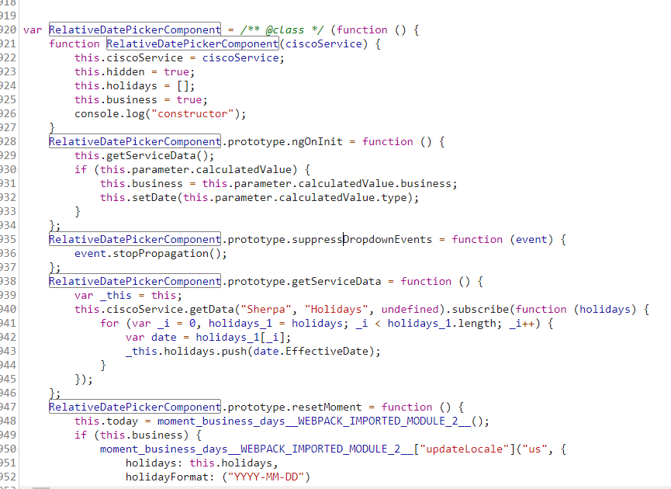

Slide 37
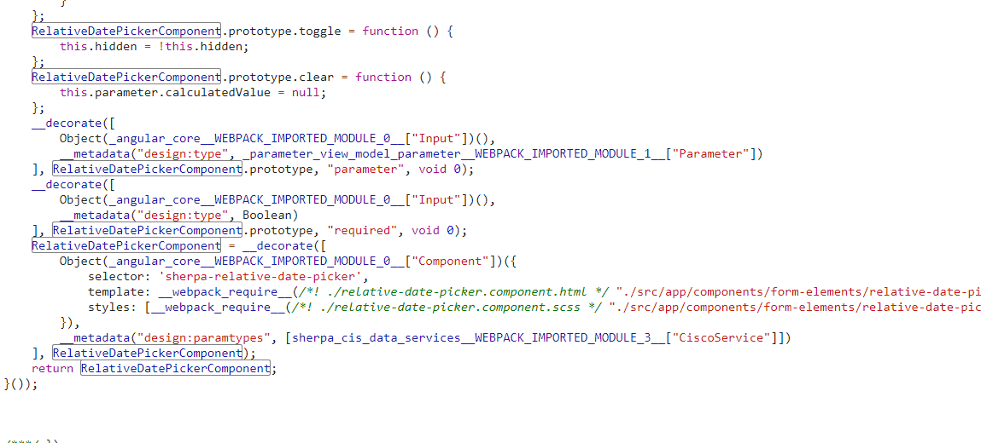

Slide 38
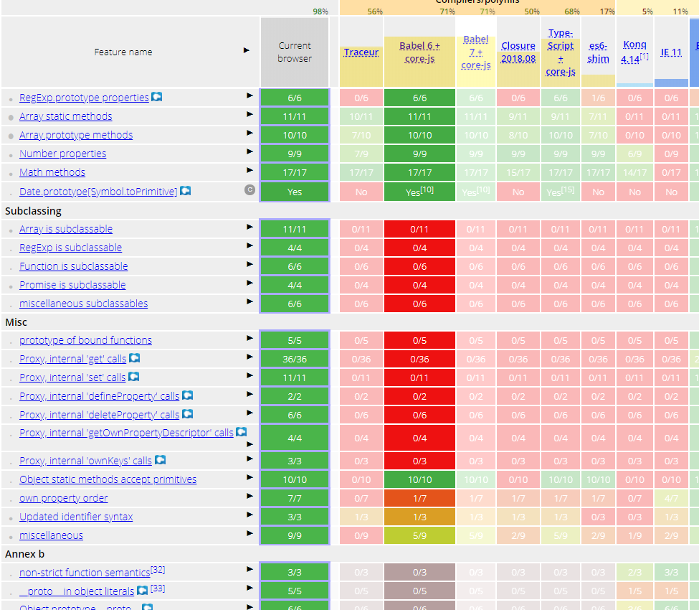

Slide 39
Application Environments

Slide 40



Fight!

Slide 41
We used to be able to view source

Slide 42
Now?
npm install -g @angular/cli
ng new angular-project
cd angular-project
npm install

Slide 43
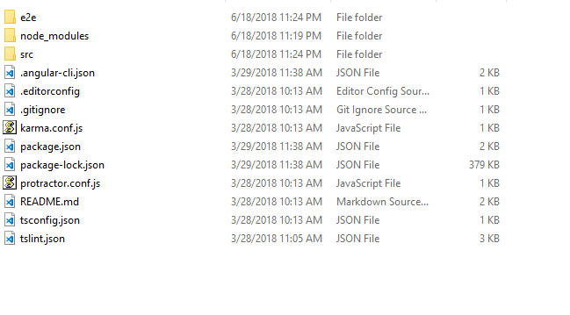
☺

Slide 44
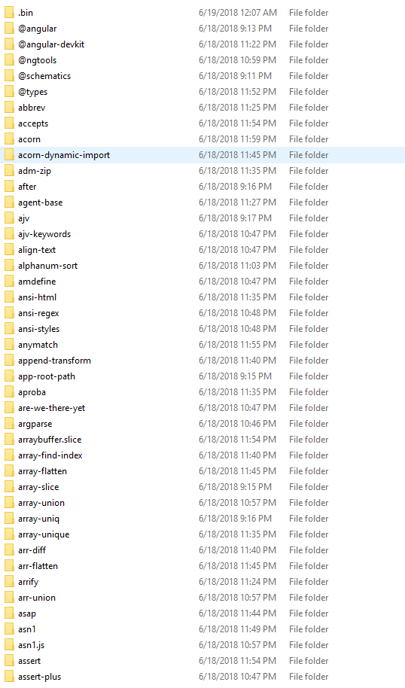
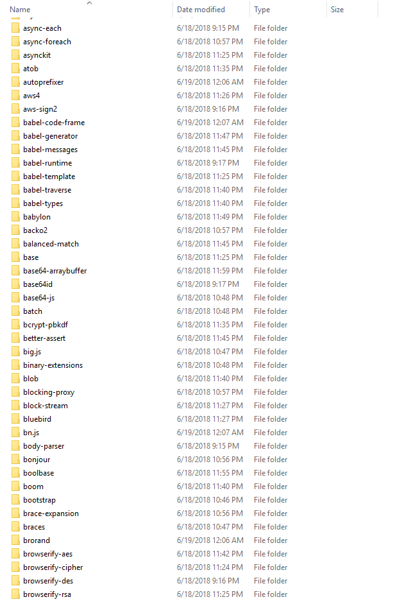

Slide 45
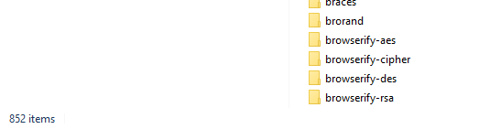
😲

Slide 46
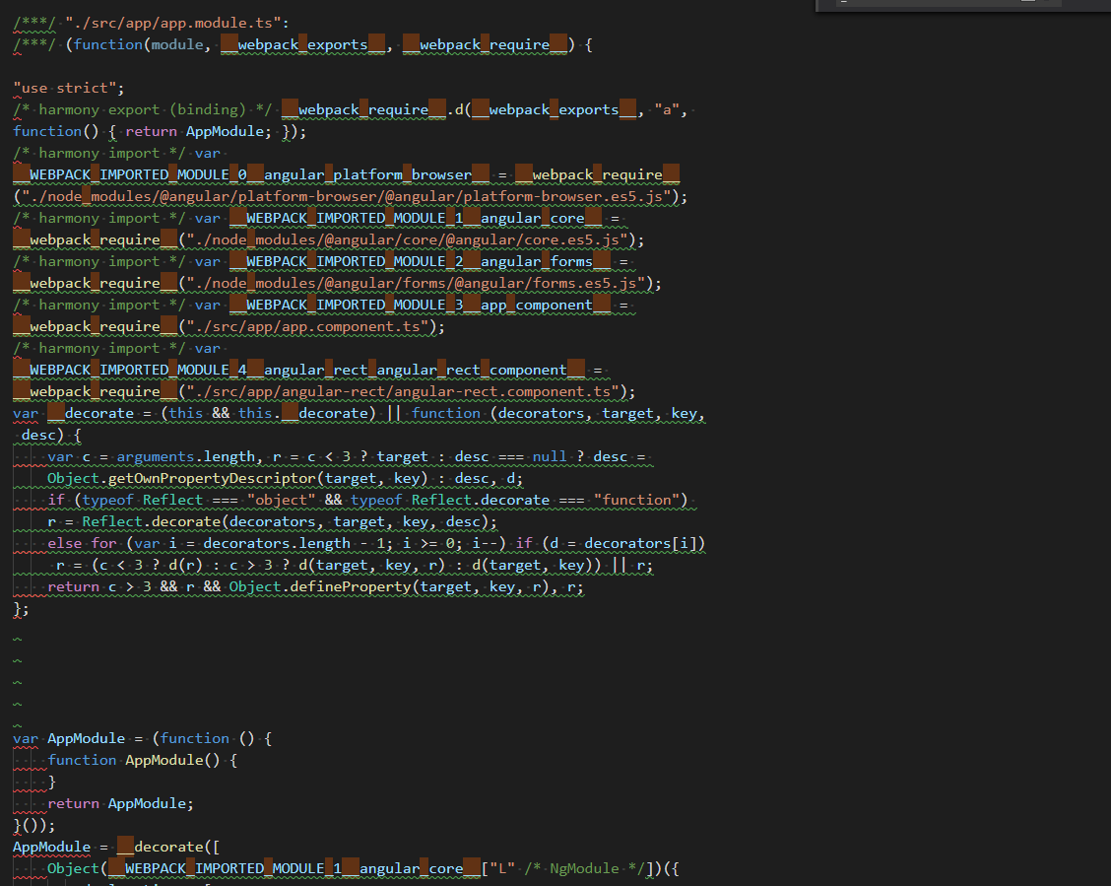
😲

Slide 47
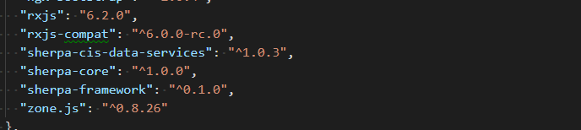
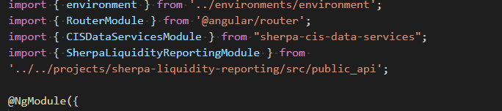
Still…

Slide 48
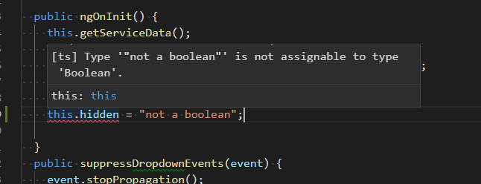
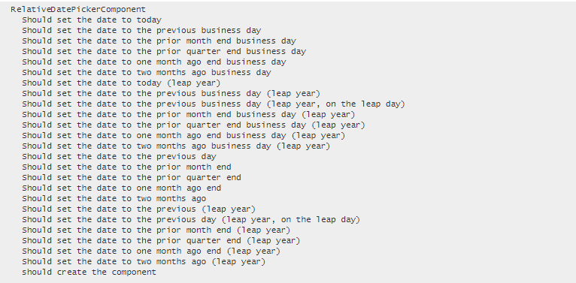

Slide 49
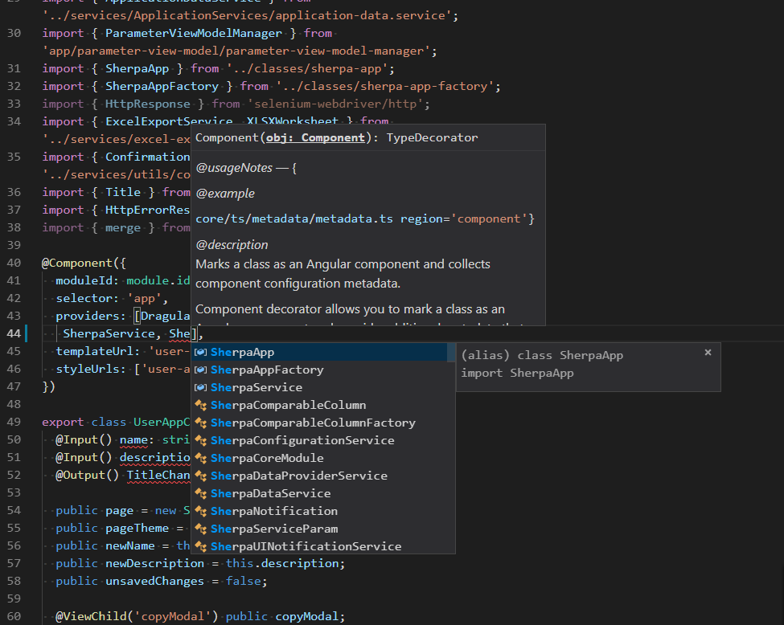

Slide 50
Thanks!

